Slide 1


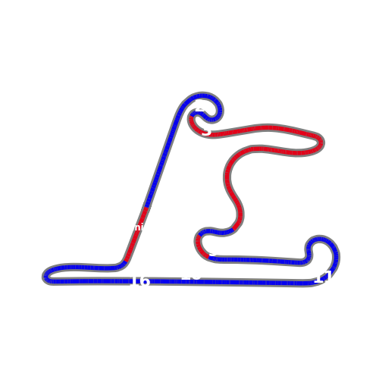
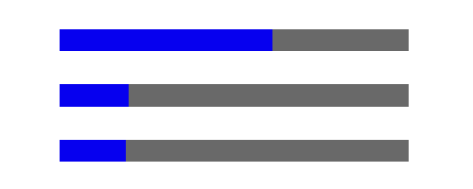

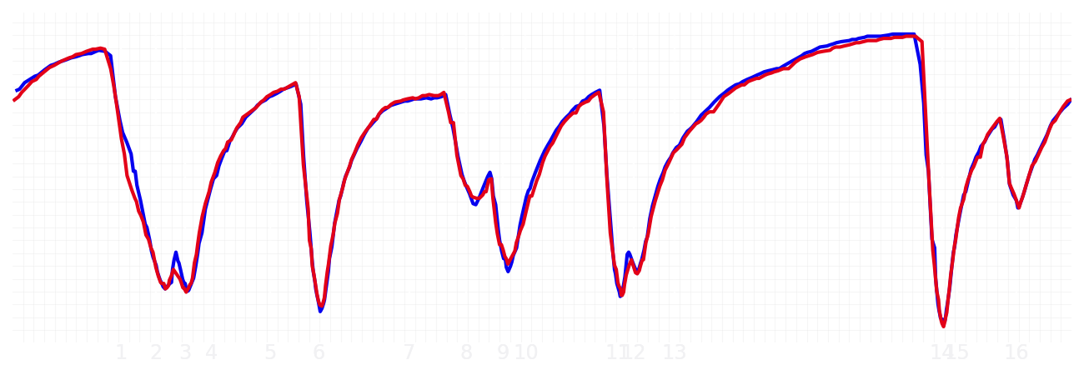
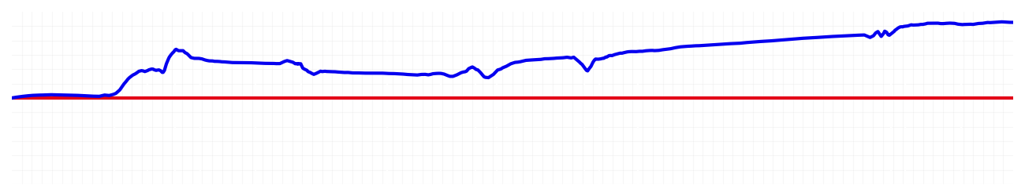
Chinese GP Qualifying Q1
Max Verstappen
Driver
Liam Lawson
Driver
Lap Time
01:31.424
01:32.174
Lap Time
Sector 1
24.256
Speed Trap 1
284 kp/h
Speed Trap 1
285 kp/h
Sector 1
24.522
Sector 2
27.505
Speed Trap 2
277 kp/h
Gap
-0.75
Gap
0.75
Speed Trap 2
275 kp/h
Sector 2
27.622
Sector 3
39.663
Speed Final Line
269 kp/h
Corner Advantage
6/17
Corner Advantage
11/17
Speed Final Line
270 kp/h
Sector 3
40.030
FULL THROTTLE
61%
60%
FULL THROTTLE
HEAVY BREAKING
20%
16%
HEAVY BREAKING
%LAP TIME
CORNERING
19%
24%
CORNERING
%LAP TIME
SPEED
SPEED
DELTA TIME
DELTA TIME

Slide 2

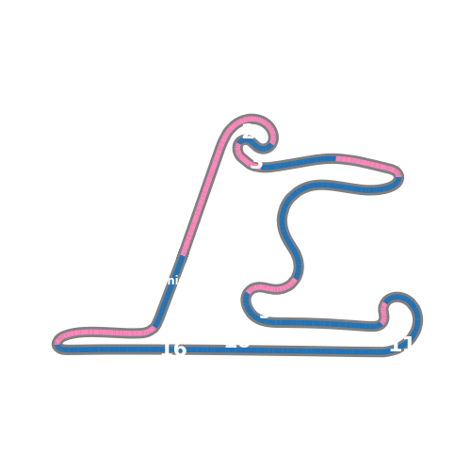
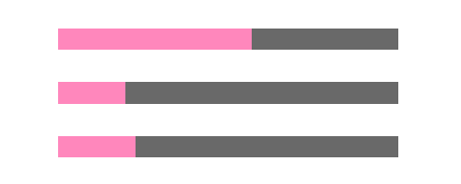

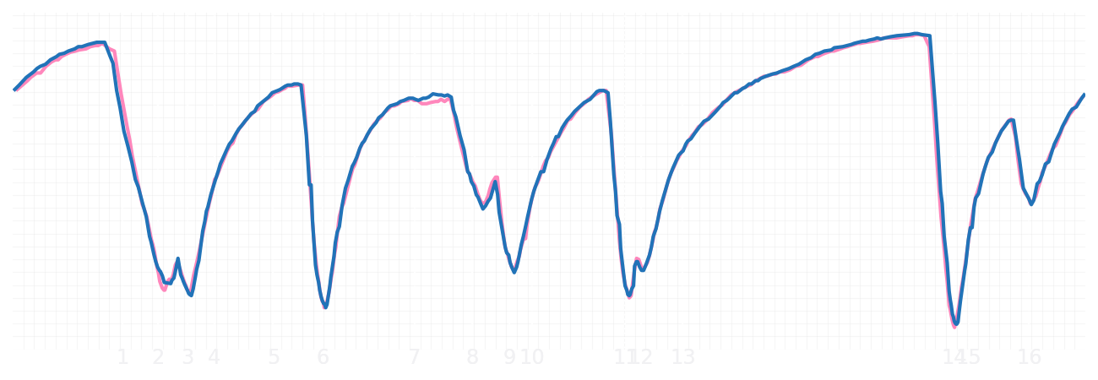
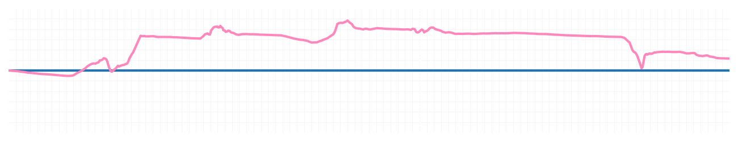
Chinese GP Qualifying Q1
Pierre Gasly
Driver
Jack Doohan
Driver
Lap Time
01:31.992
01:32.092
Lap Time
Sector 1
24.128
Speed Trap 1
282 kp/h
Speed Trap 1
284 kp/h
Sector 1
24.407
Sector 2
27.601
Speed Trap 2
276 kp/h
Gap
-0.1
Gap
0.1
Speed Trap 2
278 kp/h
Sector 2
27.655
Sector 3
40.263
Speed Final Line
270 kp/h
Corner Advantage
9/17
Corner Advantage
8/17
Speed Final Line
272 kp/h
Sector 3
40.030
FULL THROTTLE
57%
58%
FULL THROTTLE
HEAVY BREAKING
20%
20%
HEAVY BREAKING
%LAP TIME
CORNERING
23%
22%
CORNERING
%LAP TIME
SPEED
SPEED
DELTA TIME
DELTA TIME

Slide 3

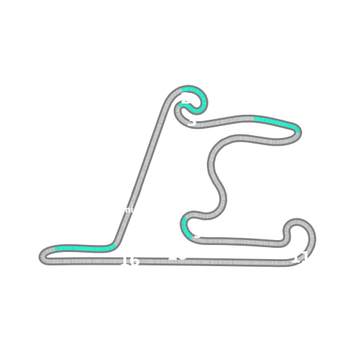


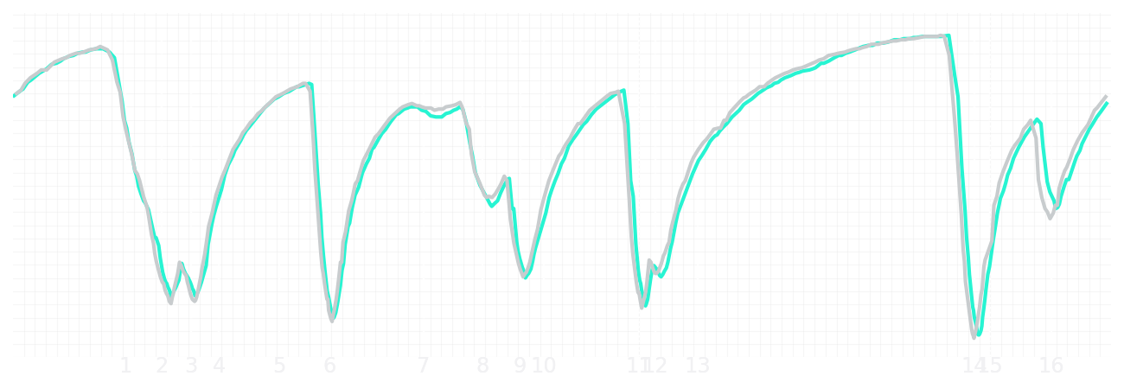
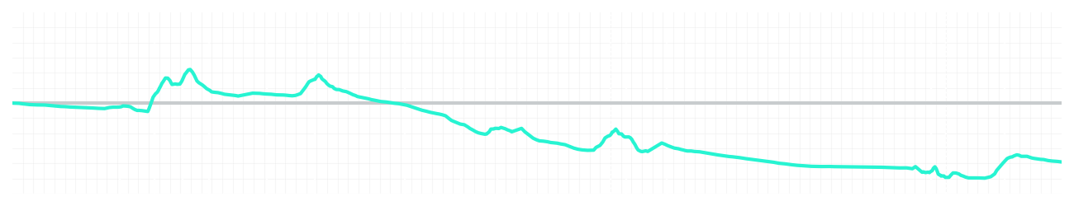
Chinese GP Qualifying Q1
Kimi Antonelli
Driver
George Russell
Driver
Lap Time
01:31.676
01:31.295
Lap Time
Sector 1
24.179
Speed Trap 1
285 kp/h
Speed Trap 1
285 kp/h
Sector 1
24.187
Sector 2
27.690
Speed Trap 2
277 kp/h
Gap
0.381
Gap
-0.381
Speed Trap 2
279 kp/h
Sector 2
27.368
Sector 3
39.807
Speed Final Line
270 kp/h
Corner Advantage
12/17
Corner Advantage
5/17
Speed Final Line
271 kp/h
Sector 3
39.740
FULL THROTTLE
55%
54%
FULL THROTTLE
HEAVY BREAKING
19%
20%
HEAVY BREAKING
%LAP TIME
CORNERING
26%
26%
CORNERING
%LAP TIME
SPEED
SPEED
DELTA TIME
DELTA TIME

Slide 4

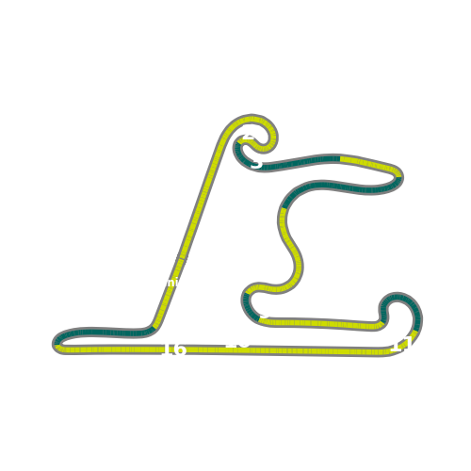


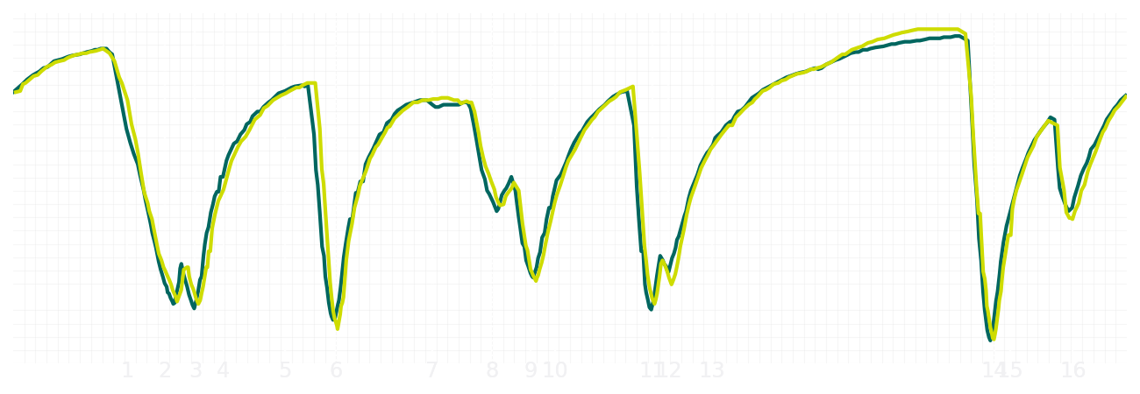
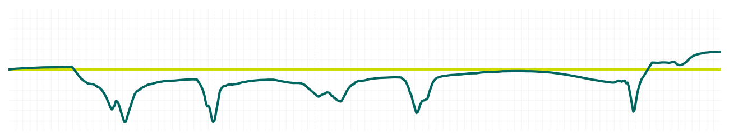
Chinese GP Qualifying Q1
Fernando Alonso
Driver
Lance Stroll
Driver
Lap Time
01:31.719
01:31.923
Lap Time
Sector 1
24.117
Speed Trap 1
282 kp/h
Speed Trap 1
283 kp/h
Sector 1
24.267
Sector 2
27.736
Speed Trap 2
276 kp/h
Gap
-0.204
Gap
0.204
Speed Trap 2
277 kp/h
Sector 2
27.617
Sector 3
39.866
Speed Final Line
271 kp/h
Corner Advantage
8/17
Corner Advantage
9/17
Speed Final Line
272 kp/h
Sector 3
40.039
FULL THROTTLE
59%
60%
FULL THROTTLE
HEAVY BREAKING
18%
18%
HEAVY BREAKING
%LAP TIME
CORNERING
23%
22%
CORNERING
%LAP TIME
SPEED
SPEED
DELTA TIME
DELTA TIME

Slide 5

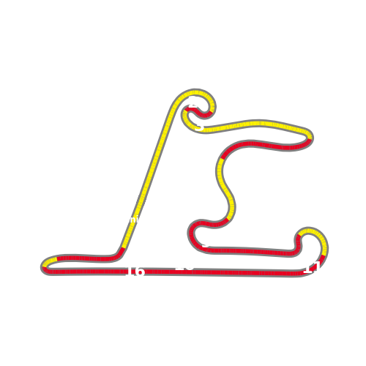


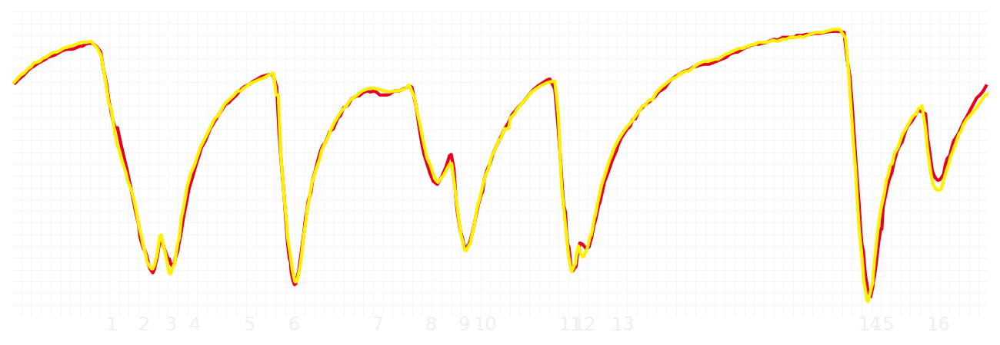
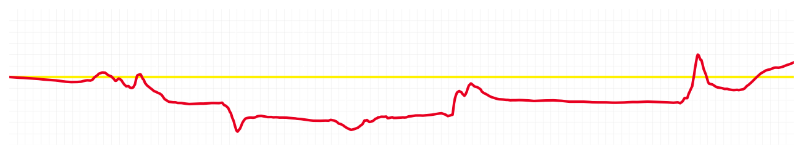
Chinese GP Qualifying Q1
Charles Leclerc
Driver
Lewis Hamilton
Driver
Lap Time
01:31.579
01:31.690
Lap Time
Sector 1
24.339
Speed Trap 1
286 kp/h
Speed Trap 1
285 kp/h
Sector 1
24.186
Sector 2
27.514
Speed Trap 2
280 kp/h
Gap
-0.111
Gap
0.111
Speed Trap 2
278 kp/h
Sector 2
27.430
Sector 3
39.726
Speed Final Line
274 kp/h
Corner Advantage
8/17
Corner Advantage
9/17
Speed Final Line
264 kp/h
Sector 3
40.074
FULL THROTTLE
56%
58%
FULL THROTTLE
HEAVY BREAKING
20%
23%
HEAVY BREAKING
%LAP TIME
CORNERING
24%
19%
CORNERING
%LAP TIME
SPEED
SPEED
DELTA TIME
DELTA TIME

Slide 6

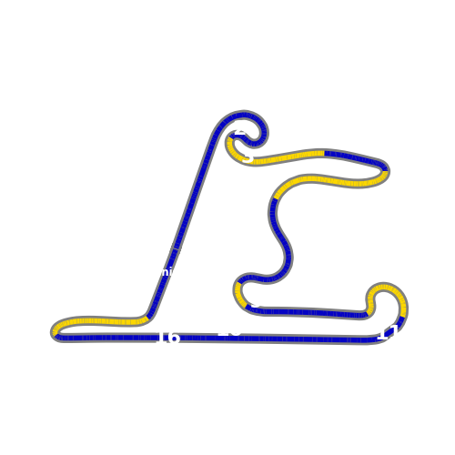

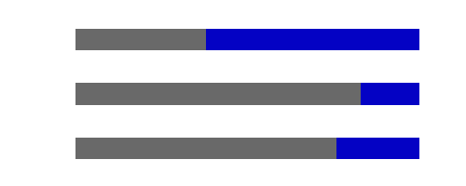
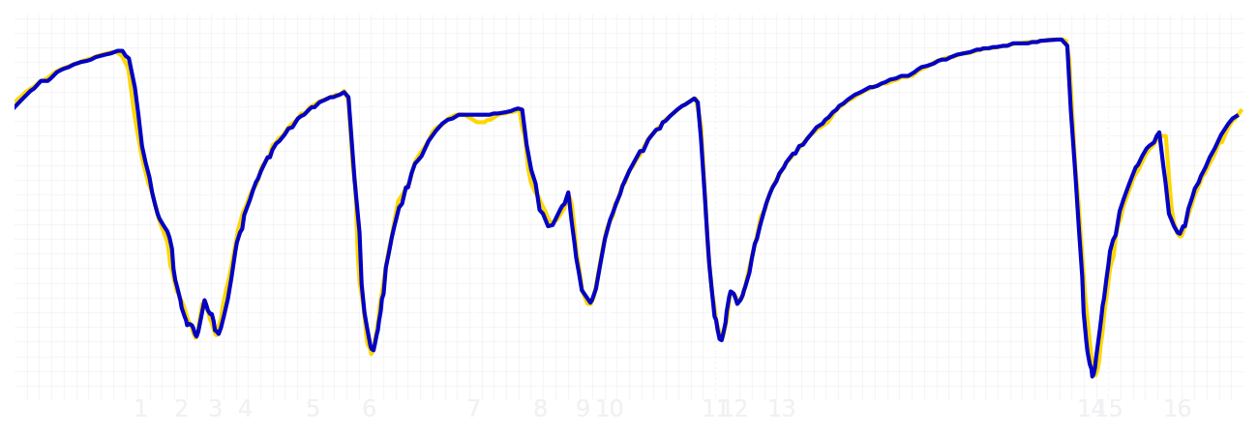
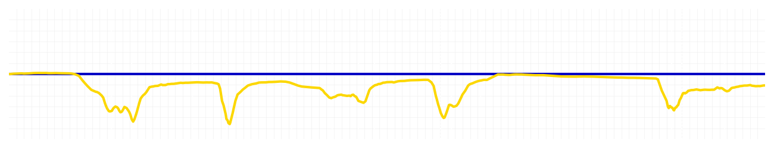
Chinese GP Qualifying Q1
Yuki Tsunoda
Driver
Isack Hadjar
Driver
Lap Time
01:31.238
01:31.162
Lap Time
Sector 1
24.276
Speed Trap 1
284 kp/h
Speed Trap 1
284 kp/h
Sector 1
24.234
Sector 2
27.203
Speed Trap 2
278 kp/h
Gap
0.076
Gap
-0.076
Speed Trap 2
278 kp/h
Sector 2
27.268
Sector 3
39.759
Speed Final Line
272 kp/h
Corner Advantage
8/17
Corner Advantage
9/17
Speed Final Line
270 kp/h
Sector 3
39.660
FULL THROTTLE
58%
62%
FULL THROTTLE
HEAVY BREAKING
18%
17%
HEAVY BREAKING
%LAP TIME
CORNERING
24%
21%
CORNERING
%LAP TIME
SPEED
SPEED
DELTA TIME
DELTA TIME

Slide 7

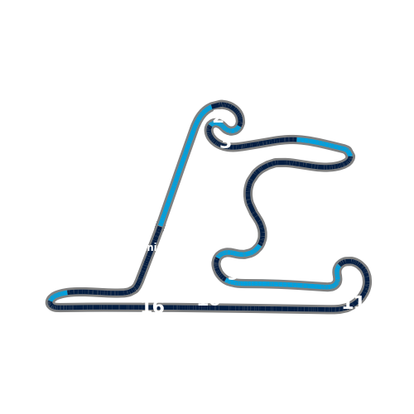


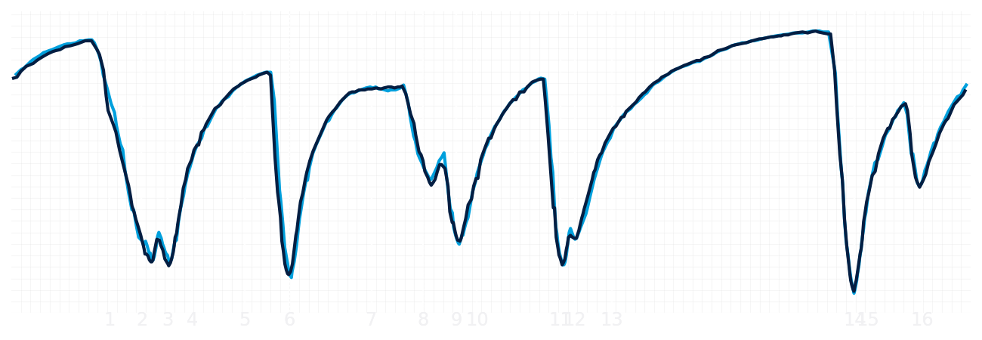
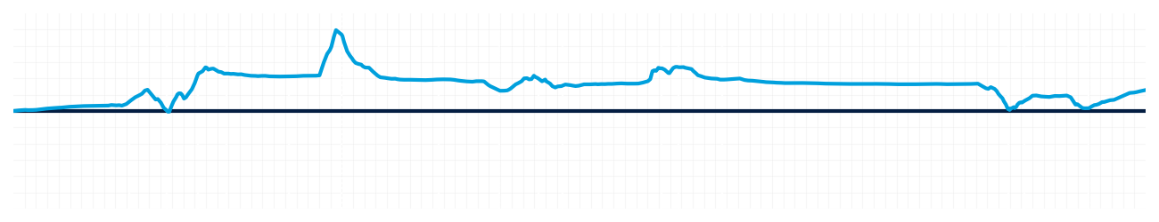
Chinese GP Qualifying Q1
Alexander Albon
Driver
Carlos Sainz
Driver
Lap Time
01:31.503
01:31.628
Lap Time
Sector 1
24.237
Speed Trap 1
284 kp/h
Speed Trap 1
284 kp/h
Sector 1
24.289
Sector 2
27.477
Speed Trap 2
278 kp/h
Gap
-0.125
Gap
0.125
Speed Trap 2
278 kp/h
Sector 2
27.480
Sector 3
39.789
Speed Final Line
273 kp/h
Corner Advantage
9/17
Corner Advantage
8/17
Speed Final Line
269 kp/h
Sector 3
39.859
FULL THROTTLE
56%
56%
FULL THROTTLE
HEAVY BREAKING
20%
21%
HEAVY BREAKING
%LAP TIME
CORNERING
24%
23%
CORNERING
%LAP TIME
SPEED
SPEED
DELTA TIME
DELTA TIME

Slide 8

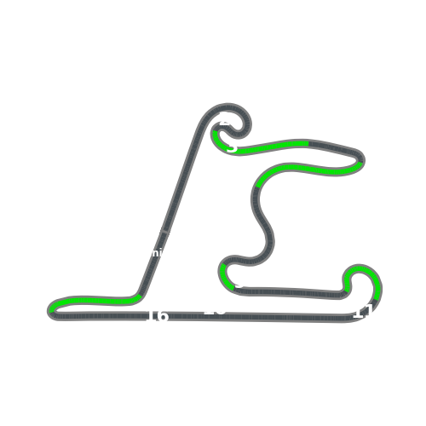


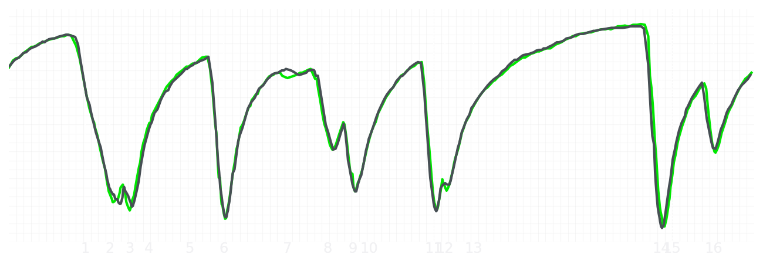
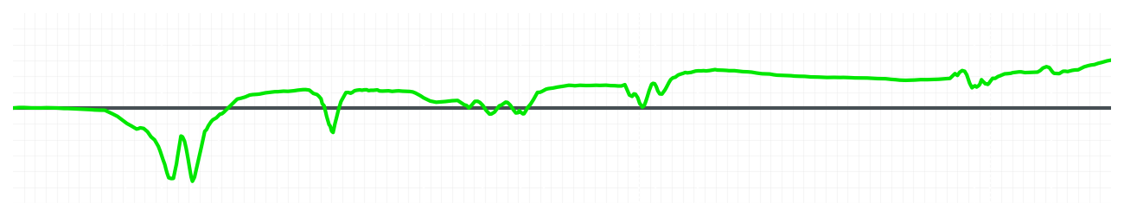
Chinese GP Qualifying Q1
Nico Hulkenberg
Driver
Gabriel Bortoleto
Driver
Lap Time
01:31.921
01:32.141
Lap Time
Sector 1
24.303
Speed Trap 1
285 kp/h
Speed Trap 1
285 kp/h
Sector 1
24.516
Sector 2
27.609
Speed Trap 2
279 kp/h
Gap
-0.22
Gap
0.22
Speed Trap 2
278 kp/h
Sector 2
27.517
Sector 3
40.009
Speed Final Line
269 kp/h
Corner Advantage
8/17
Corner Advantage
9/17
Speed Final Line
263 kp/h
Sector 3
40.108
FULL THROTTLE
58%
58%
FULL THROTTLE
HEAVY BREAKING
20%
19%
HEAVY BREAKING
%LAP TIME
CORNERING
22%
23%
CORNERING
%LAP TIME
SPEED
SPEED
DELTA TIME
DELTA TIME

Slide 9

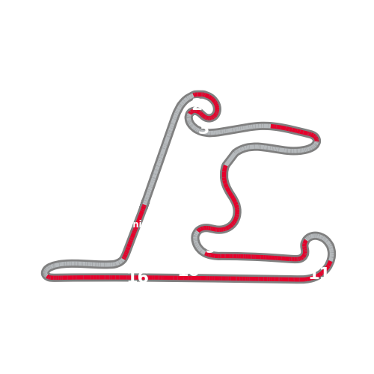


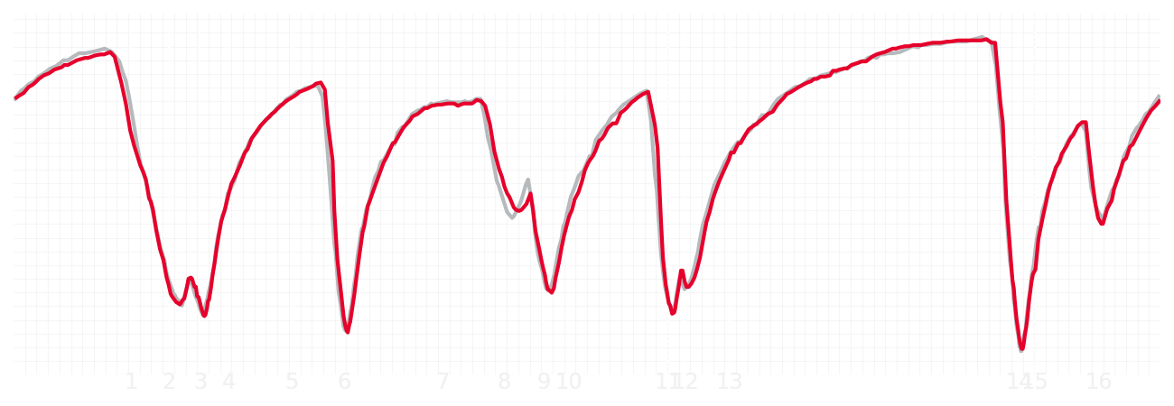
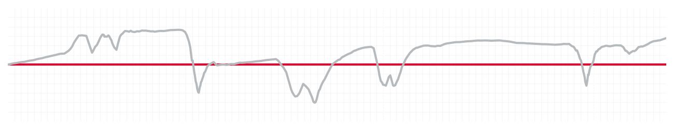
Chinese GP Qualifying Q1
Esteban Ocon
Driver
Ollie Bearman
Driver
Lap Time
01:31.876
01:32.018
Lap Time
Sector 1
24.244
Speed Trap 1
285 kp/h
Speed Trap 1
286 kp/h
Sector 1
24.427
Sector 2
27.609
Speed Trap 2
279 kp/h
Gap
-0.142
Gap
0.142
Speed Trap 2
277 kp/h
Sector 2
27.599
Sector 3
40.023
Speed Final Line
272 kp/h
Corner Advantage
8/17
Corner Advantage
9/17
Speed Final Line
270 kp/h
Sector 3
39.992
FULL THROTTLE
58%
58%
FULL THROTTLE
HEAVY BREAKING
21%
21%
HEAVY BREAKING
%LAP TIME
CORNERING
21%
21%
CORNERING
%LAP TIME
SPEED
SPEED
DELTA TIME
DELTA TIME

Slide 10

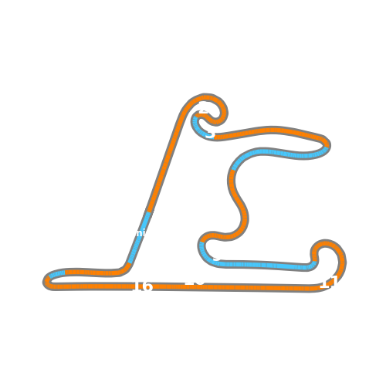

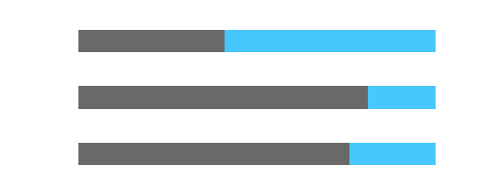
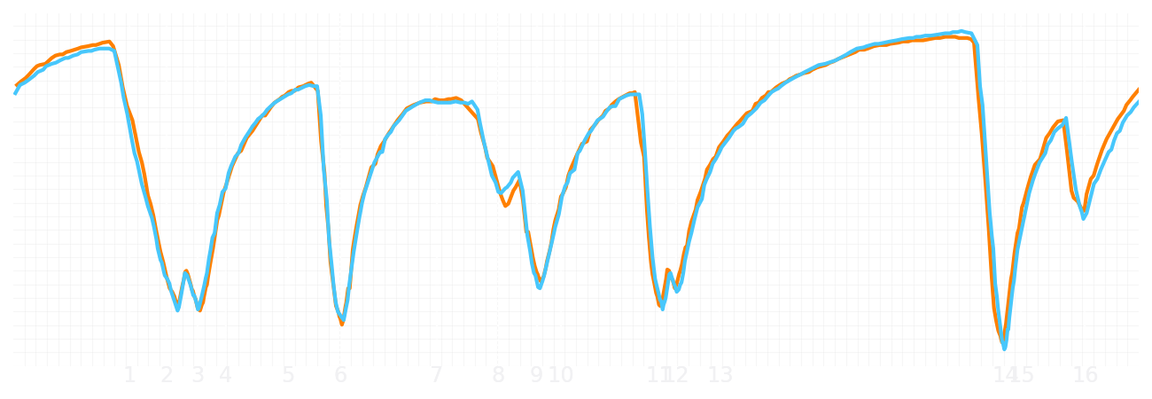
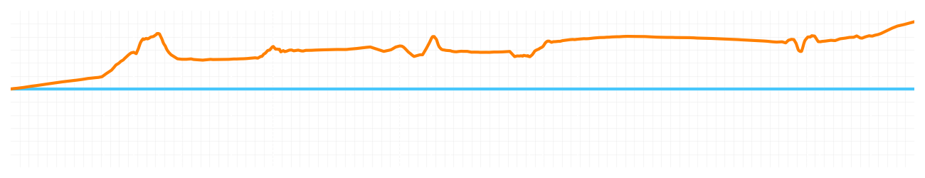
Chinese GP Qualifying Q1
Lando Norris
Driver
Oscar Piastri
Driver
Lap Time
01:30.983
01:31.591
Lap Time
Sector 1
23.966
Speed Trap 1
283 kp/h
Speed Trap 1
282 kp/h
Sector 1
24.176
Sector 2
27.348
Speed Trap 2
277 kp/h
Gap
-0.608
Gap
0.608
Speed Trap 2
276 kp/h
Sector 2
27.442
Sector 3
39.669
Speed Final Line
274 kp/h
Corner Advantage
5/17
Corner Advantage
12/17
Speed Final Line
268 kp/h
Sector 3
39.973
FULL THROTTLE
59%
59%
FULL THROTTLE
HEAVY BREAKING
17%
19%
HEAVY BREAKING
%LAP TIME
CORNERING
24%
22%
CORNERING
%LAP TIME
SPEED
SPEED
DELTA TIME
DELTA TIME

